Slide 1
SOCIAL-GAMIFYING BIKE SAFETY
TEAM HERALD
Notes:
In our project pitch, our team proposed to make a smartphone application that promotes safer biking behaviors through social gamification. To refresh ourselves on the project, let’s follow around this man here

Slide 2
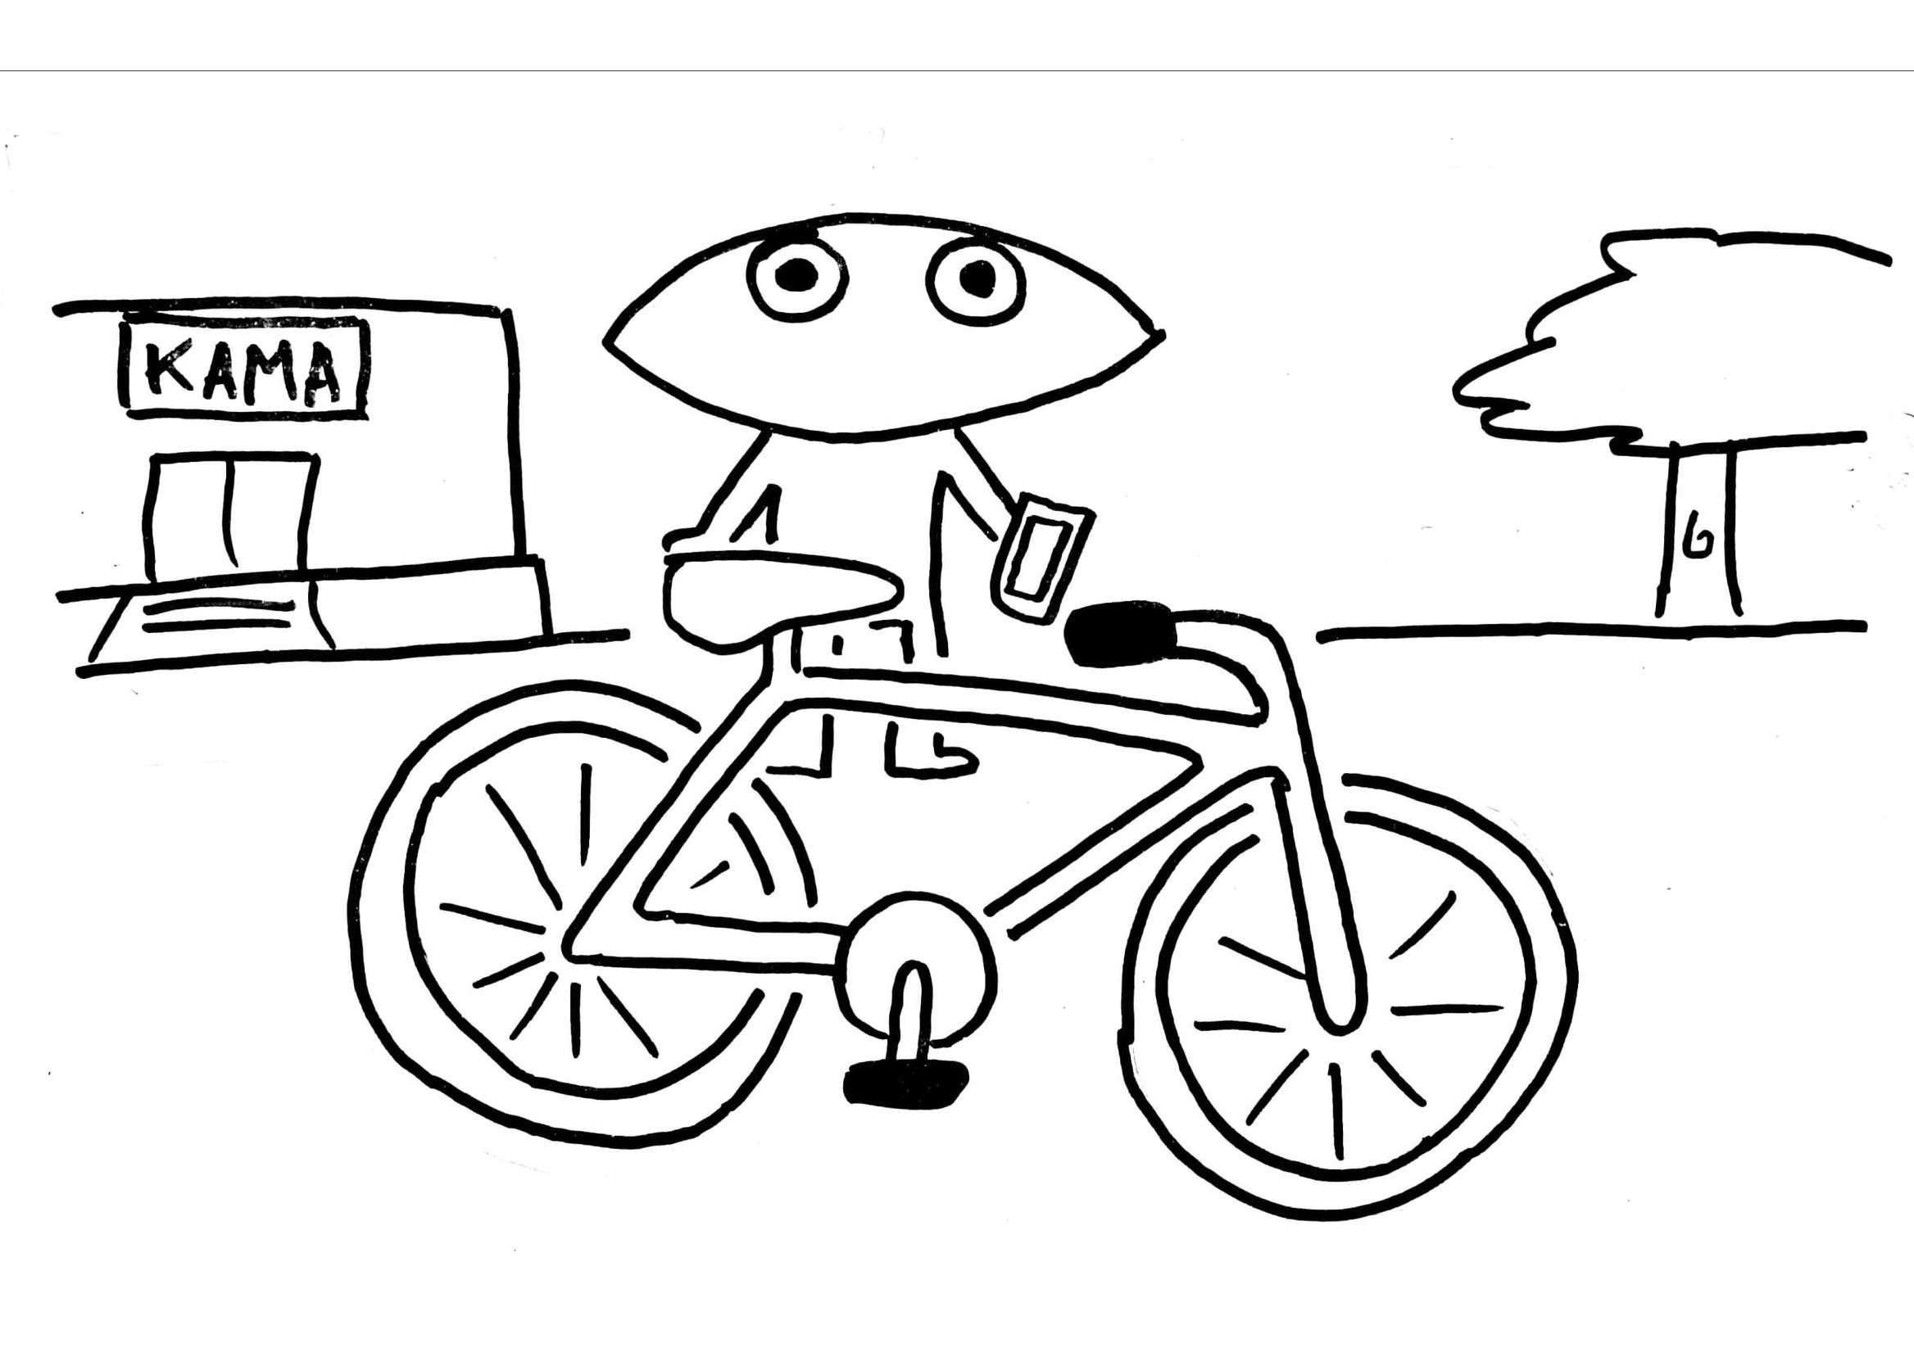

Slide 3
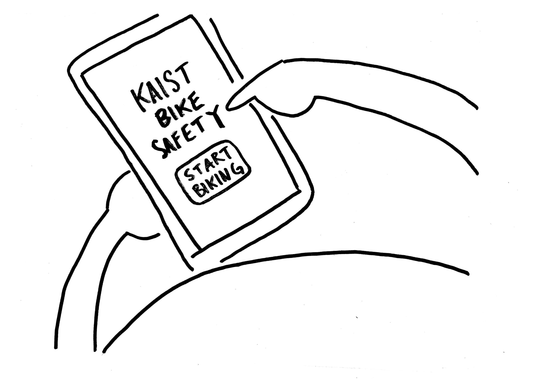

Slide 4
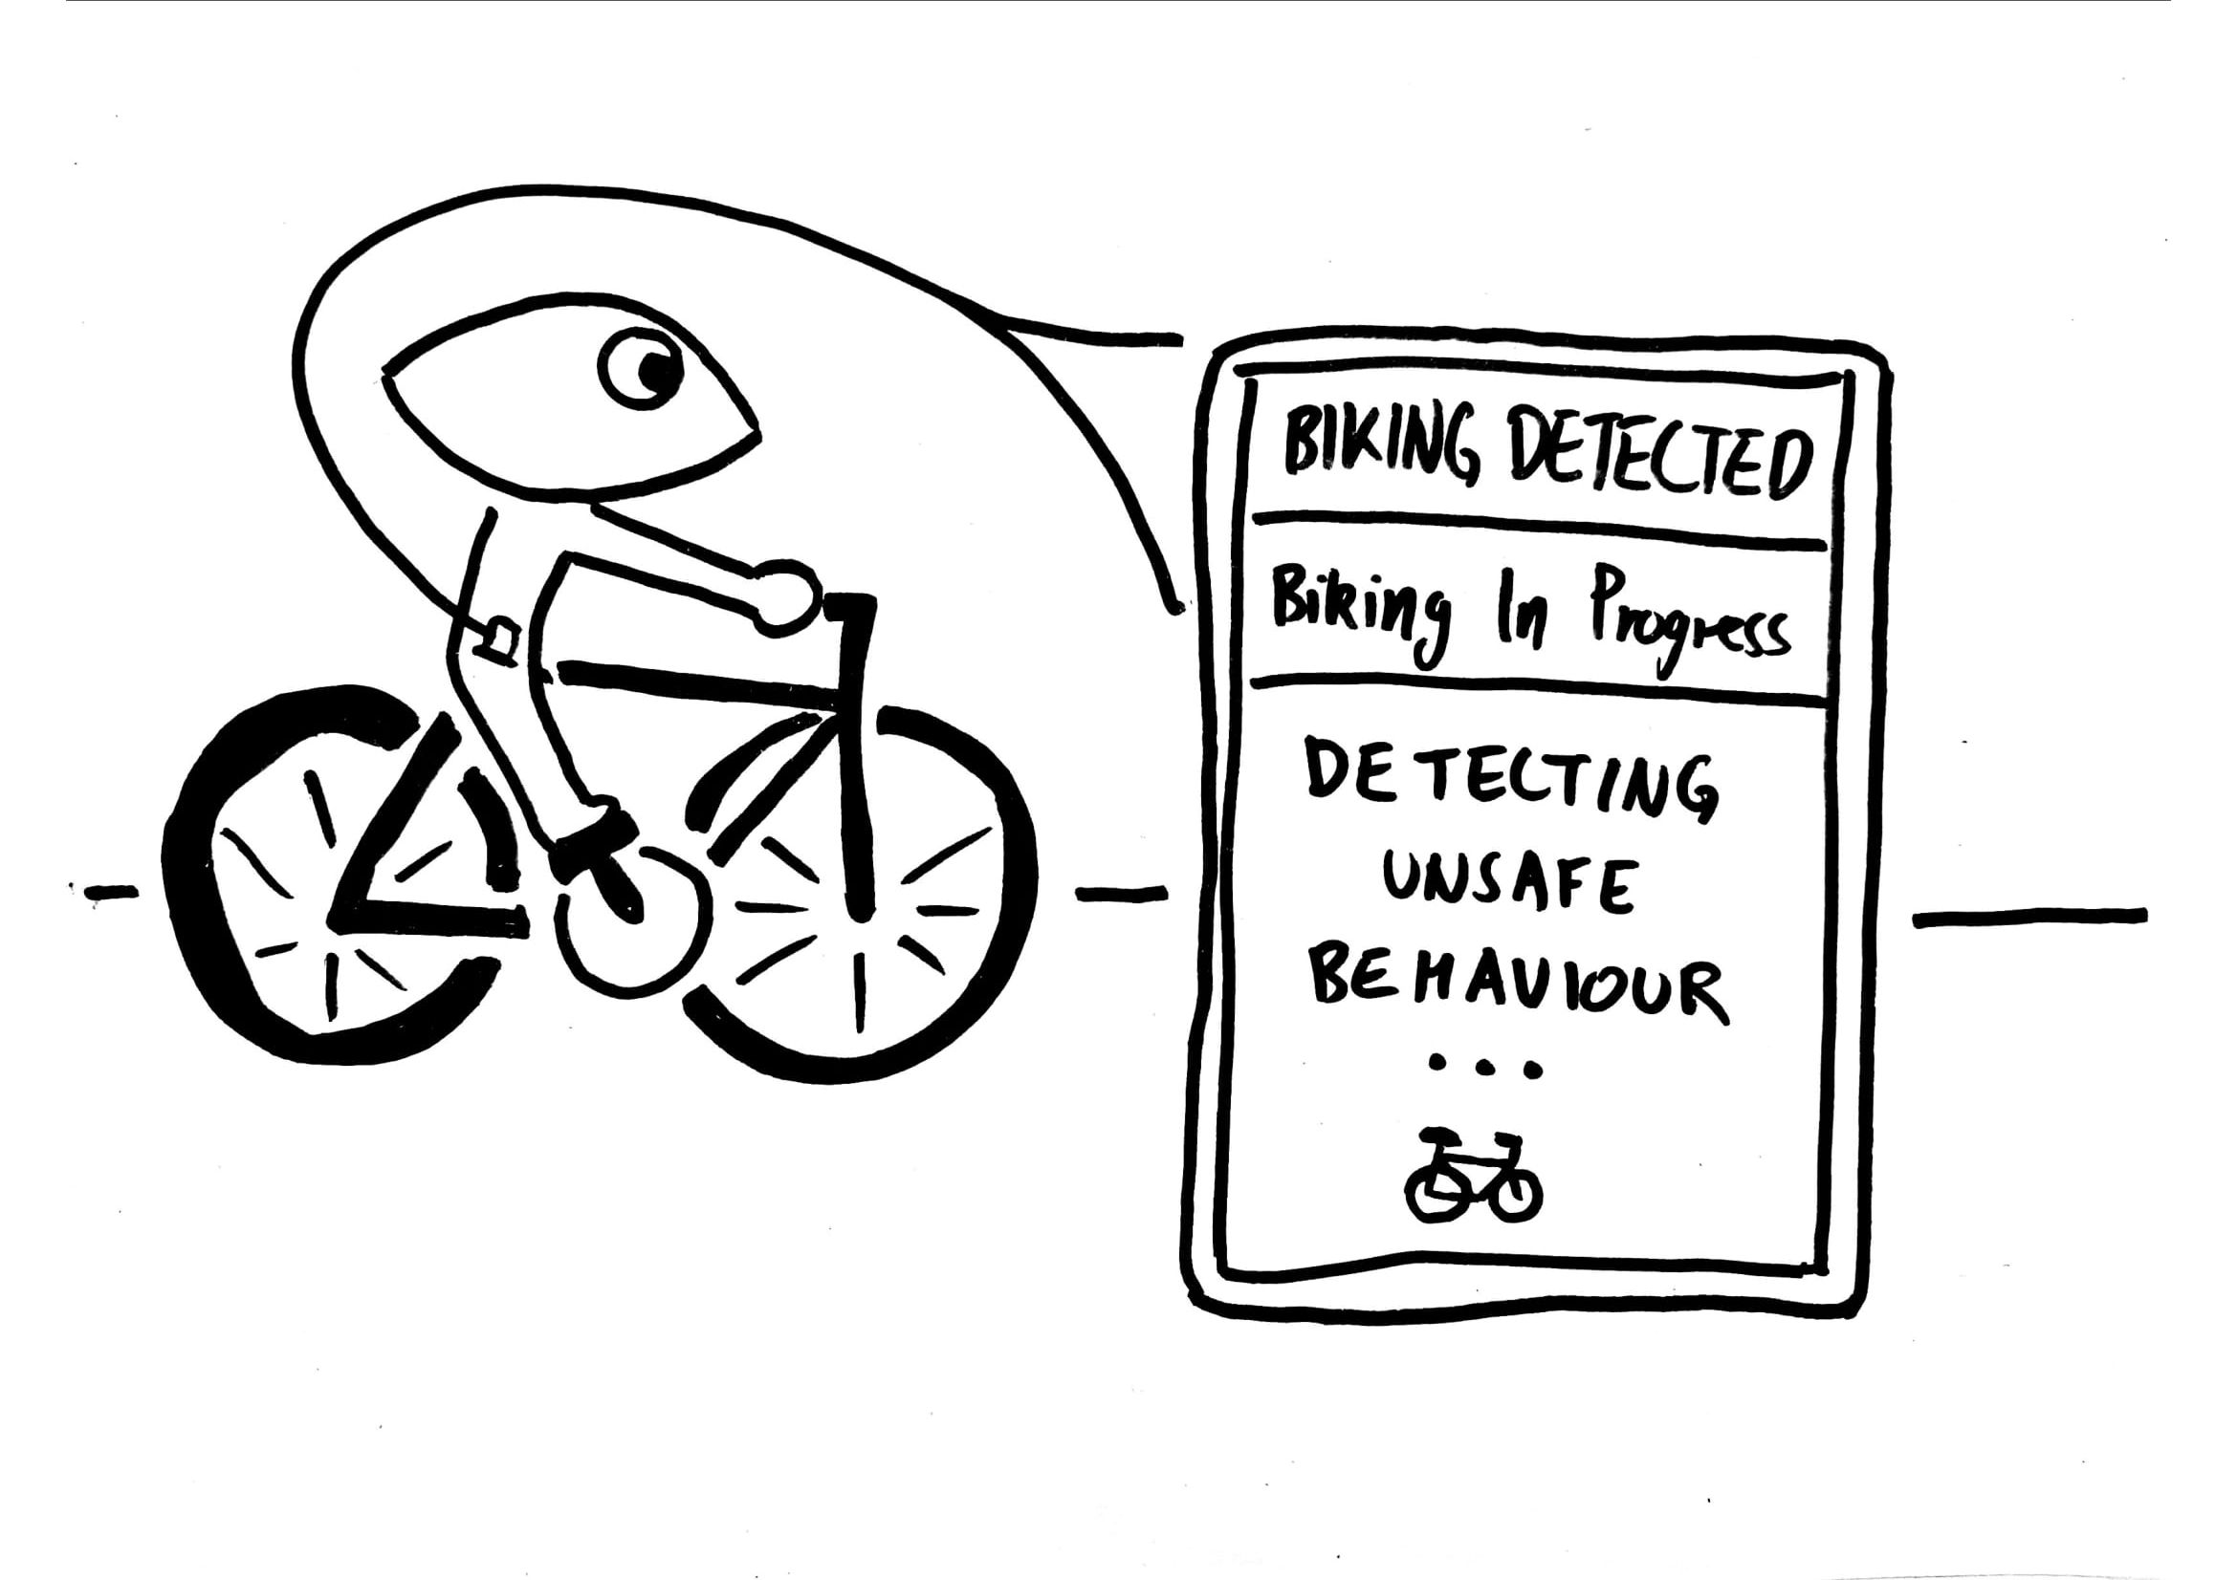
Notes:
…
In the meanwhile, our application collects smartphone sensor data in the background.

Slide 5
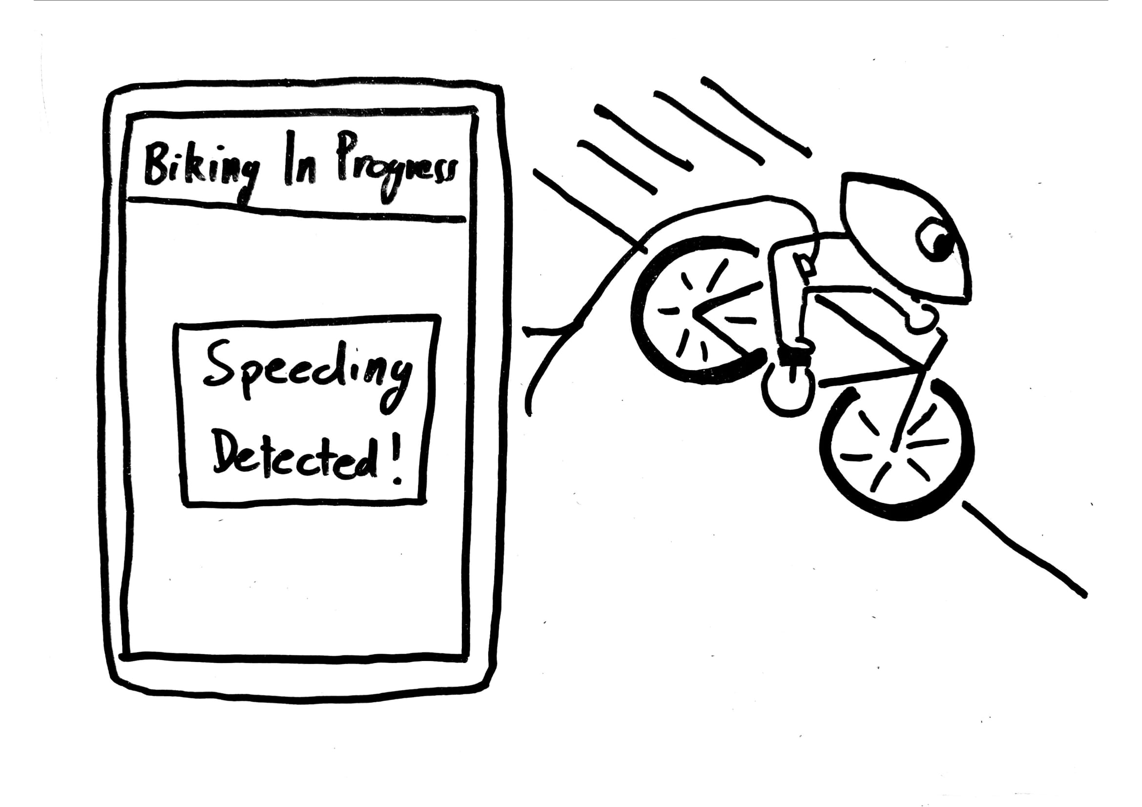
Notes:
He soon starts going downhill, and his bike starts

Slide 6
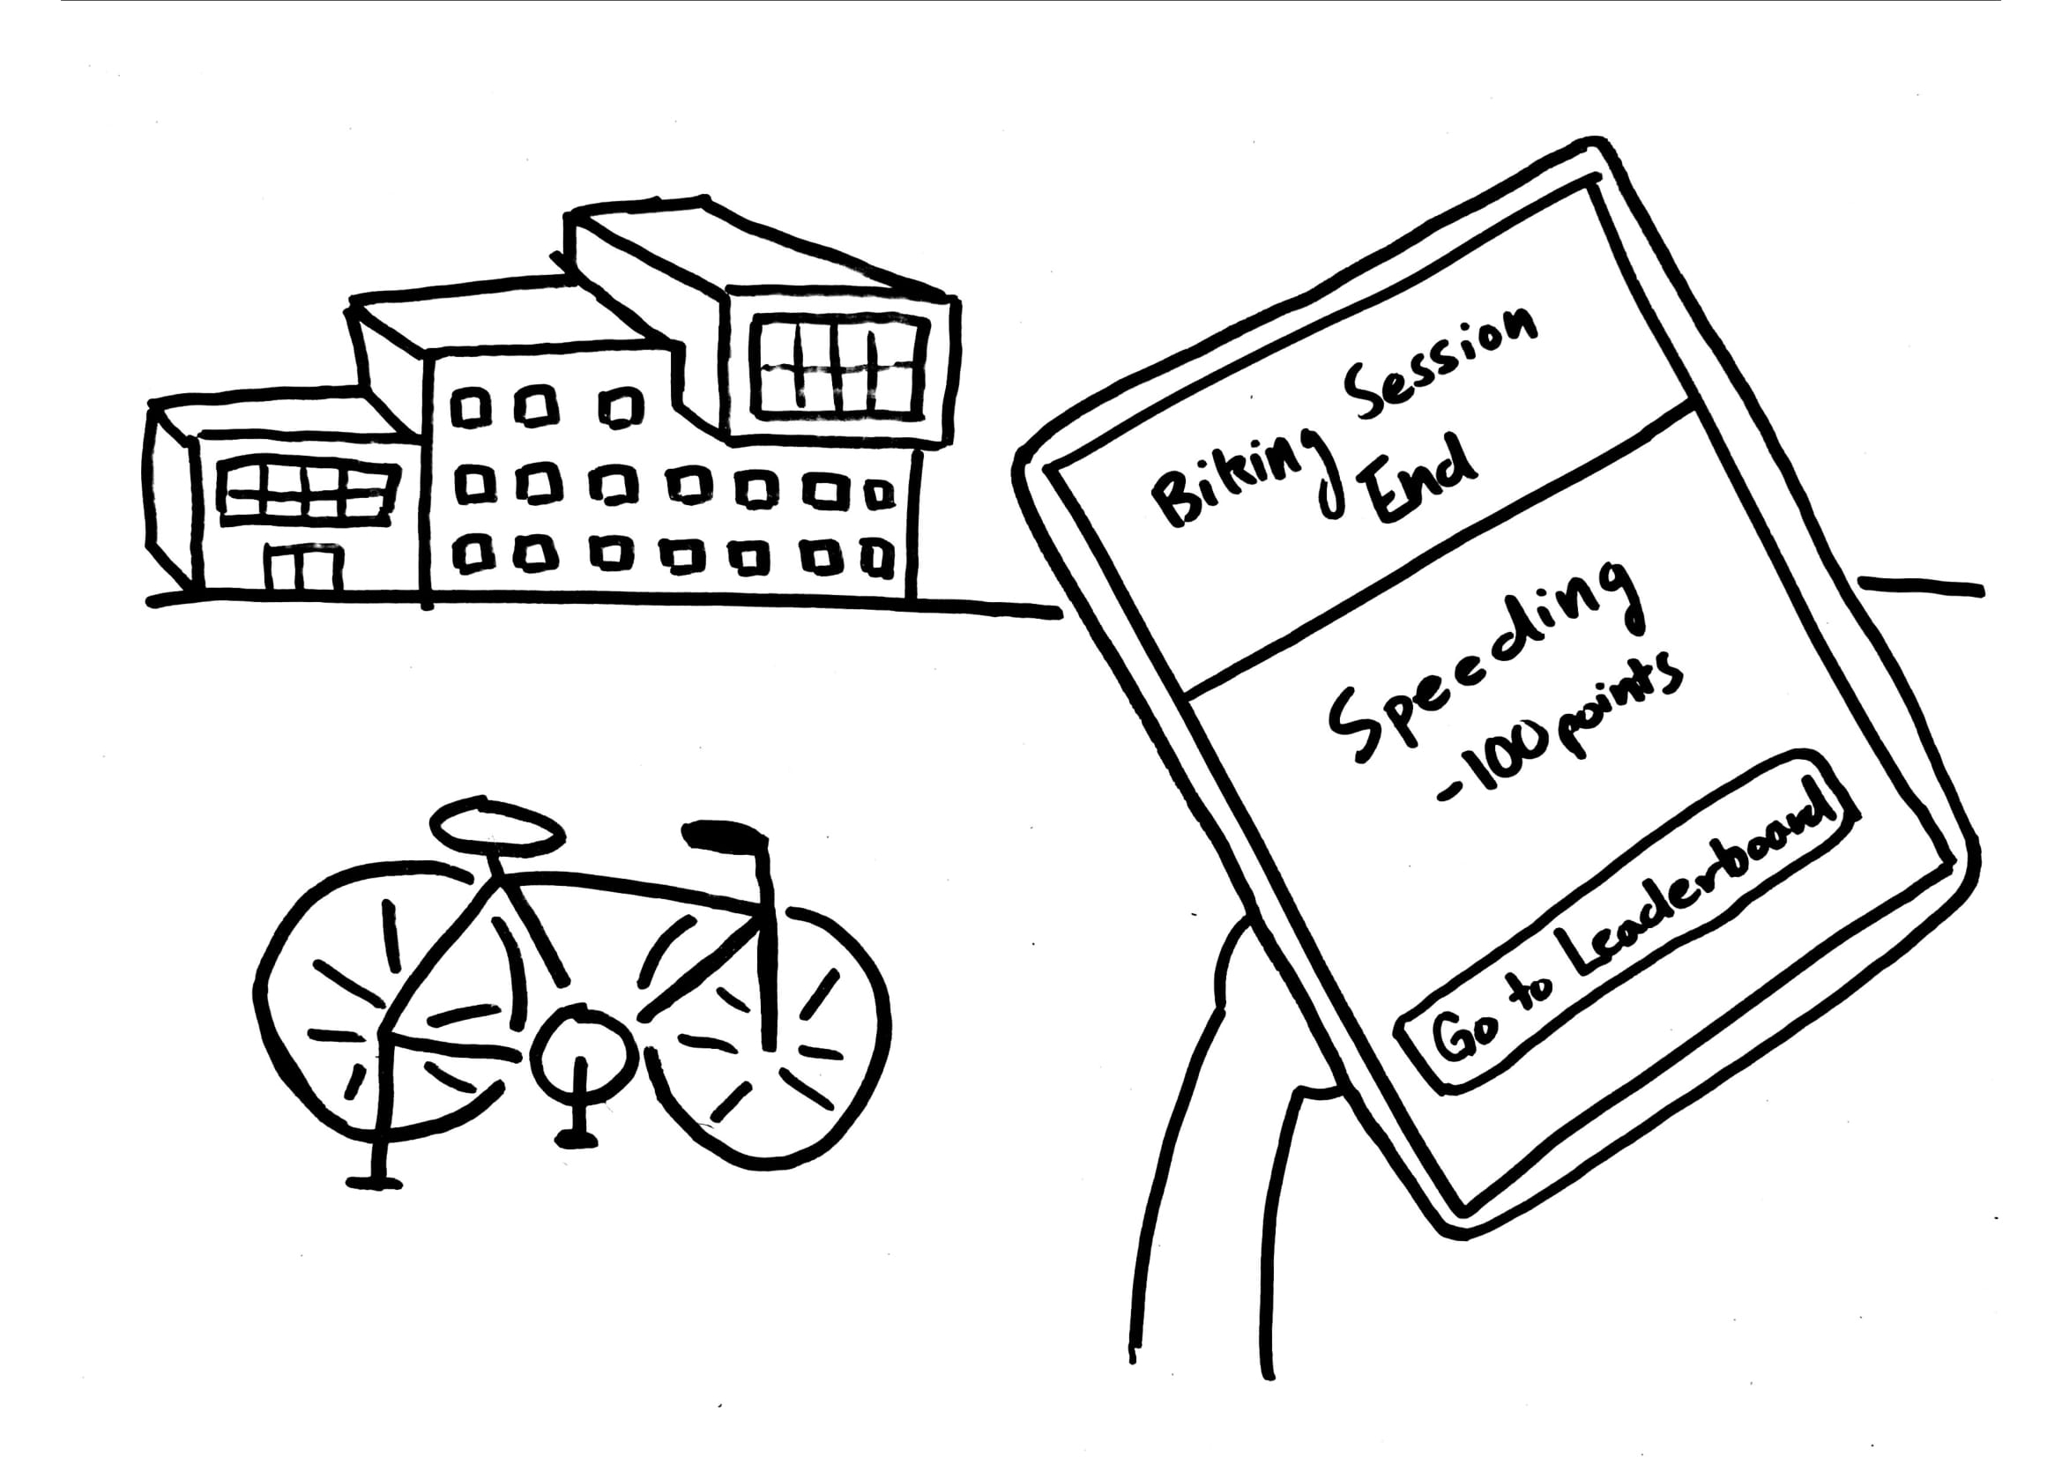

Slide 7
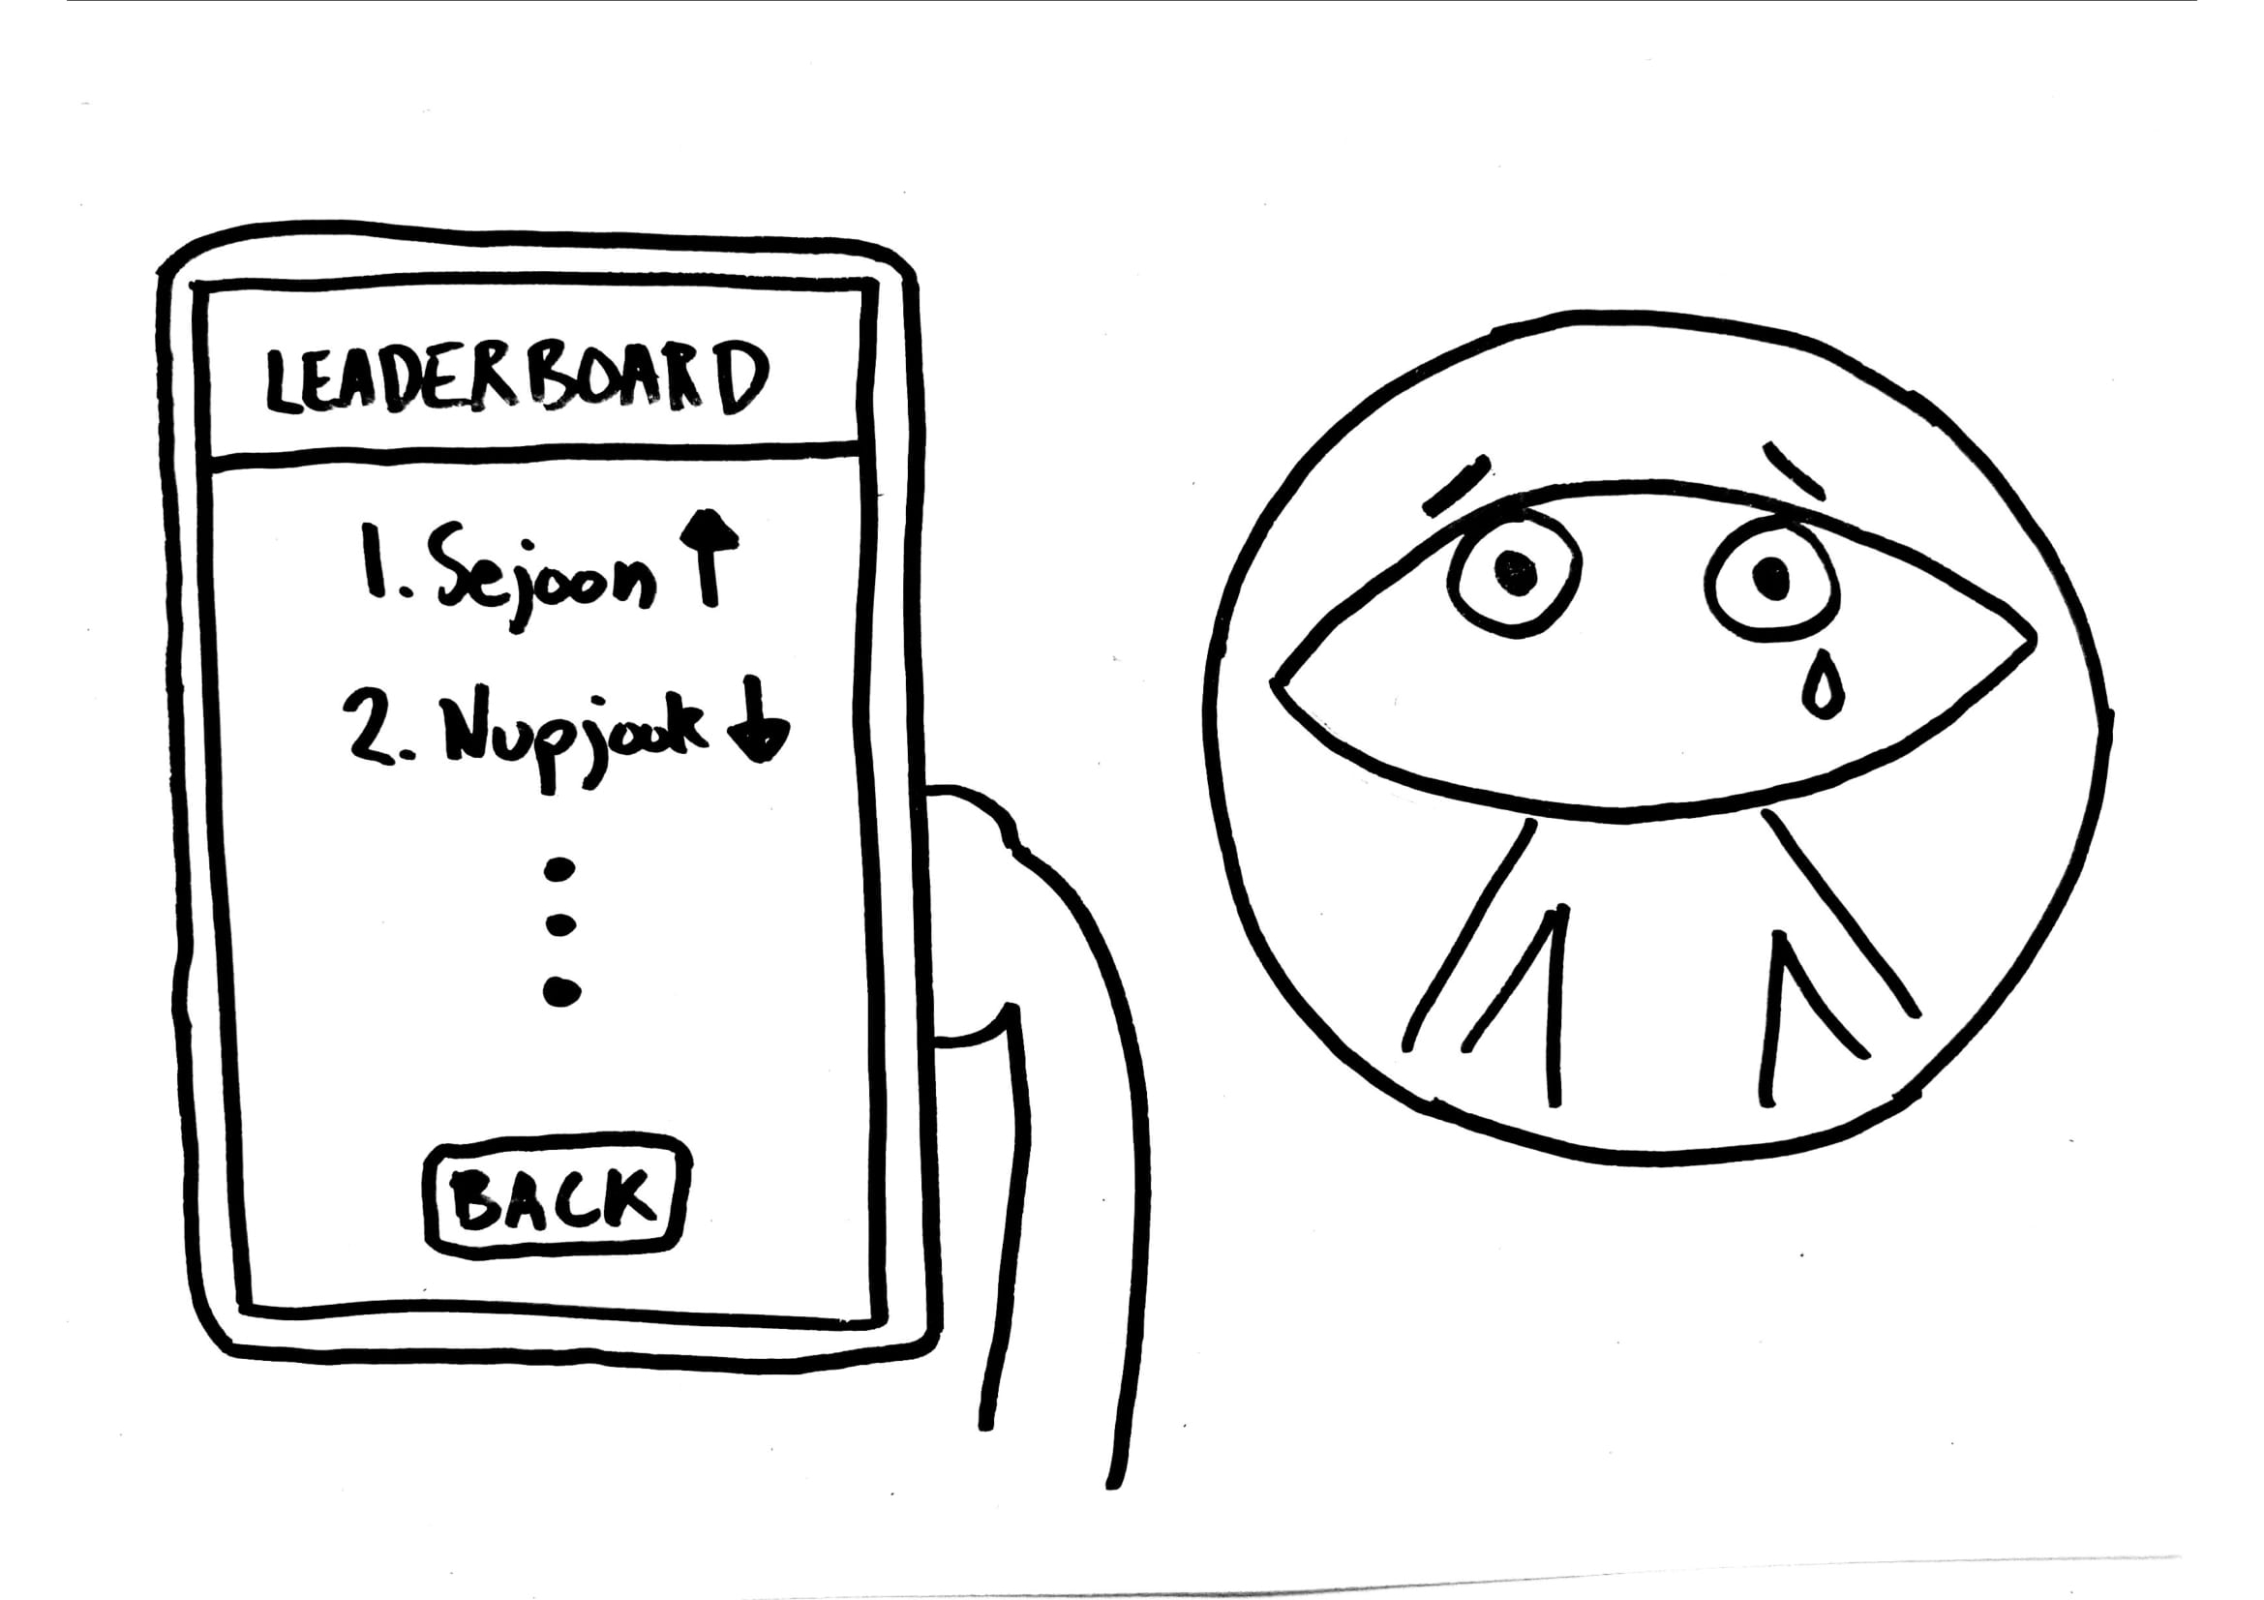

Slide 8
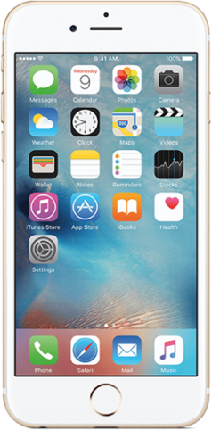
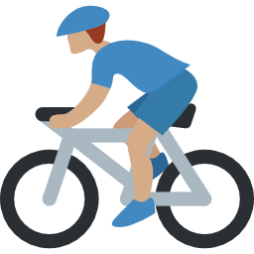

Two-Fold Challenge
Detection
Social Gamification
Notes:
As demonstrated, our project has a two-fold challenge when viewed broadly. We first detect unsafe biking behavior using smartphone sensors, and incentivize users by adding social gamification features. And this is what we said for our project pitch as well.

Slide 9
Questions We Received
Individual Biking Habits?
Potential Collision?
Lack of Biker Attention?
What social features are you adding?
Why add a game?
Will users play it while biking?
Detection
Social Gamification
Notes:
However it was unclear as to what exactly we were detecintg as there a number of possibilities

Slide 10
Questions We Received
Individual Biking Habits?
Potential Collision?
Lack of Biker Attention?
Why gamify the app?
What social features are you adding?
Will users play it while biking?
Detection
Detection
Social Gamification
Social Gamification
Notes:
And it remained unclear how and why we intended to gamify our application.

Slide 11
Require no user input/interaction while biking & phone in pocket
How individual users turn/speed instead of potential accidents
Problem Statement
Passively detect personal biking habits and motivate bike safety by providing post-biking feedback with a socially gamified approach
No real-time alerts; feedback will be given after they are done biking
Effective method of Incentivisation
Notes:
We now aim to

Slide 12

Part 1: Detection
Social Gamification
Detection

Slide 13
What is “unsafe” biking?
Notes:
In beginning this project, we asked ourselves a question.

Slide 14
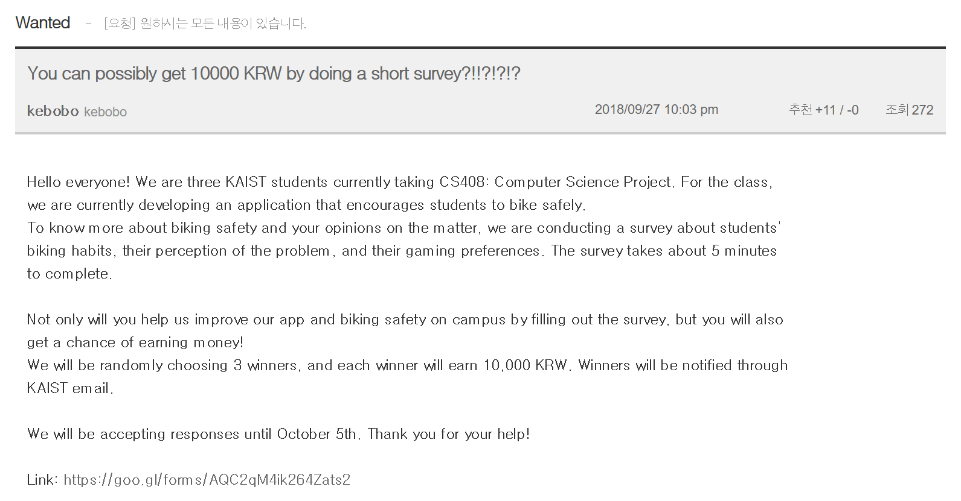
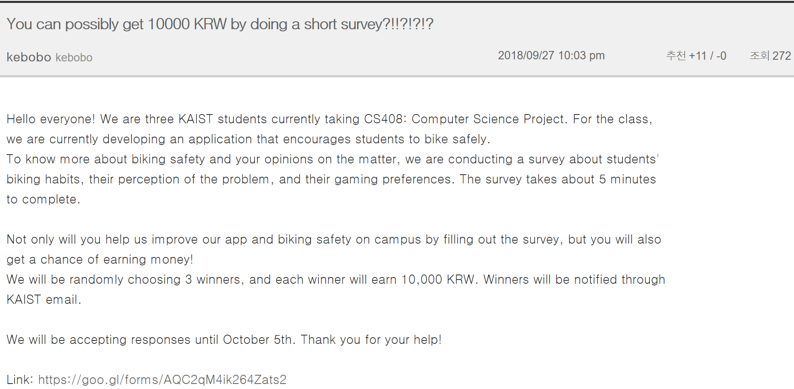


Launched a campus-wide survey
Week-long survey
194 Responses from KAIST students
Notes:
179 people survey
Recently launched a survey, and from analysing the accidents and categorizing the causes for those accidents, we were able to identiy the top causes for unsafe biking and

Slide 15
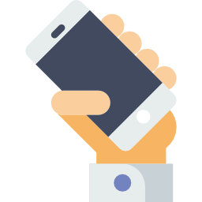


“Describe the accident”
“Have you ever been in a bike accident?”
60 Accidents
Testing
Not slowing down at Intersections
Speeding while Turning
Biking in rain/snow
Biking in wrong lane
Phone use
Notes:
Through this survey we found that a total of 60 people have gotten into accidents before. To analyse

Slide 16



Detectable
Speeding
Intersections
Lane positions
Walking vs Biking
+
Notes:
So in order to see if we could detect these scenarios, we got around to testing and successfully detecting a few things such as speeding.

Slide 17


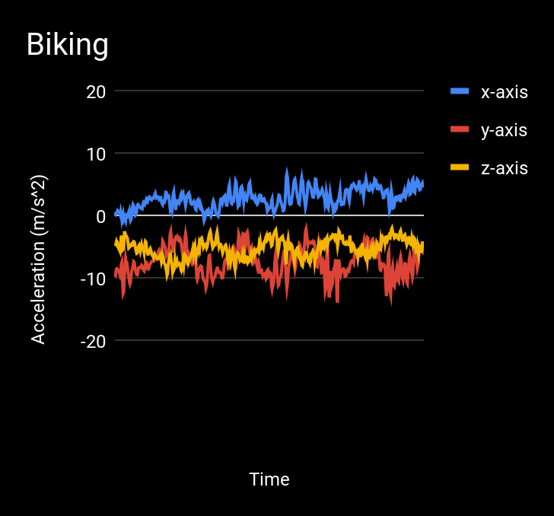
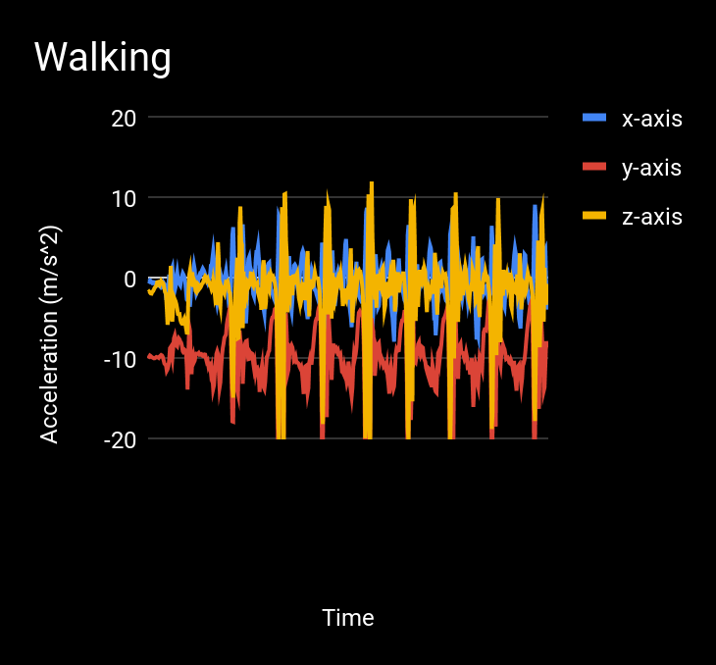
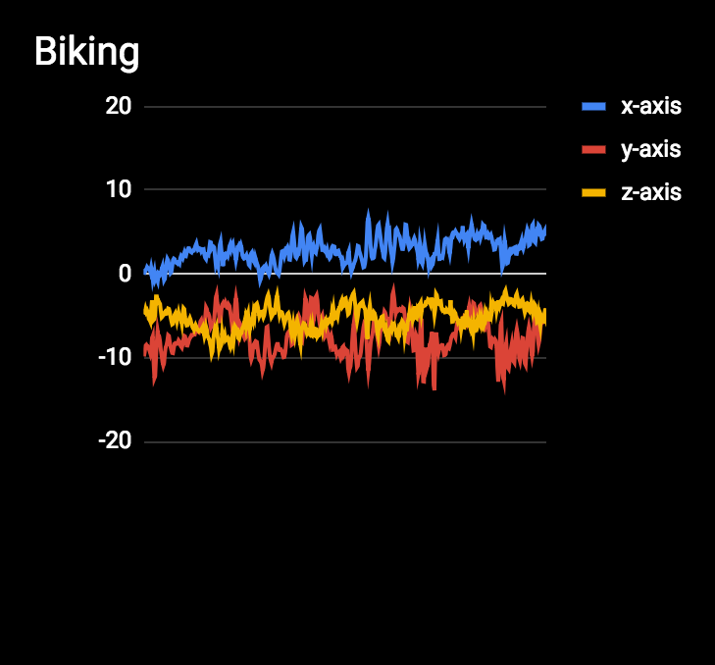
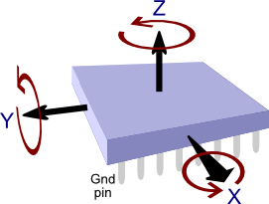
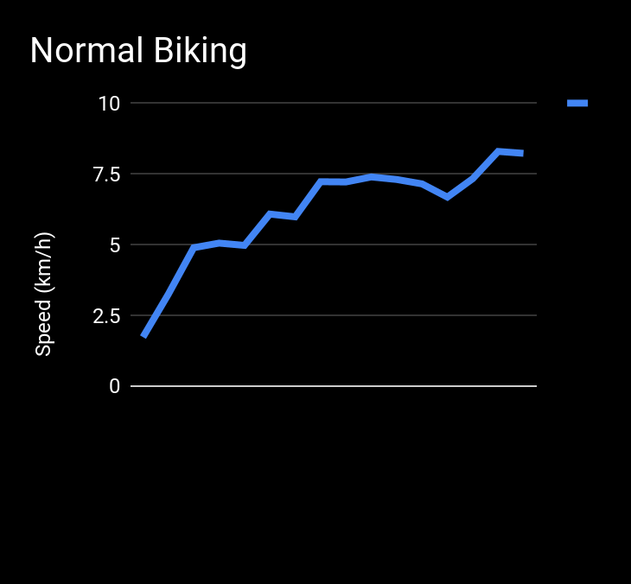
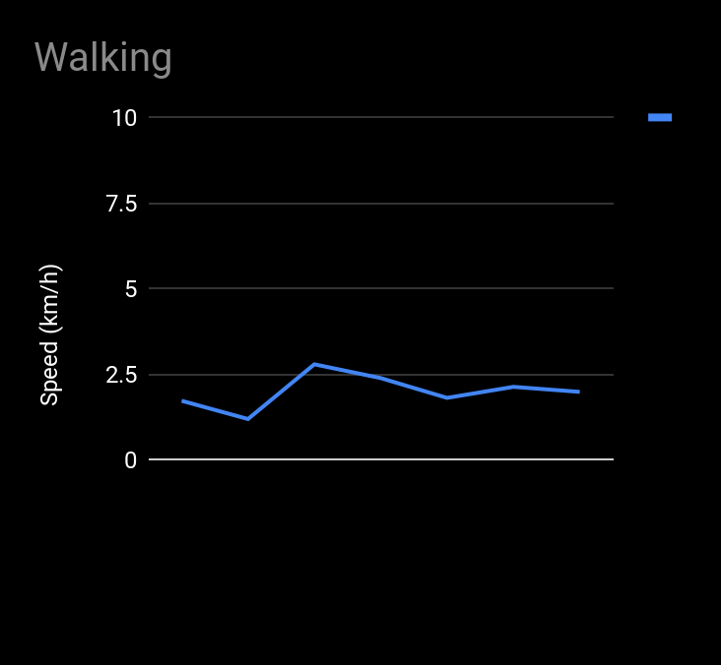
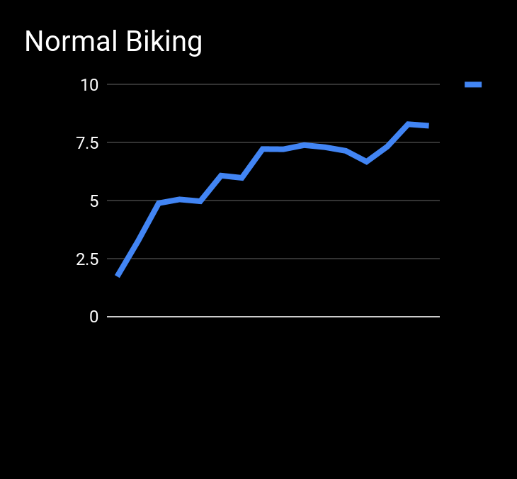

We can classify walking vs biking

Slide 18
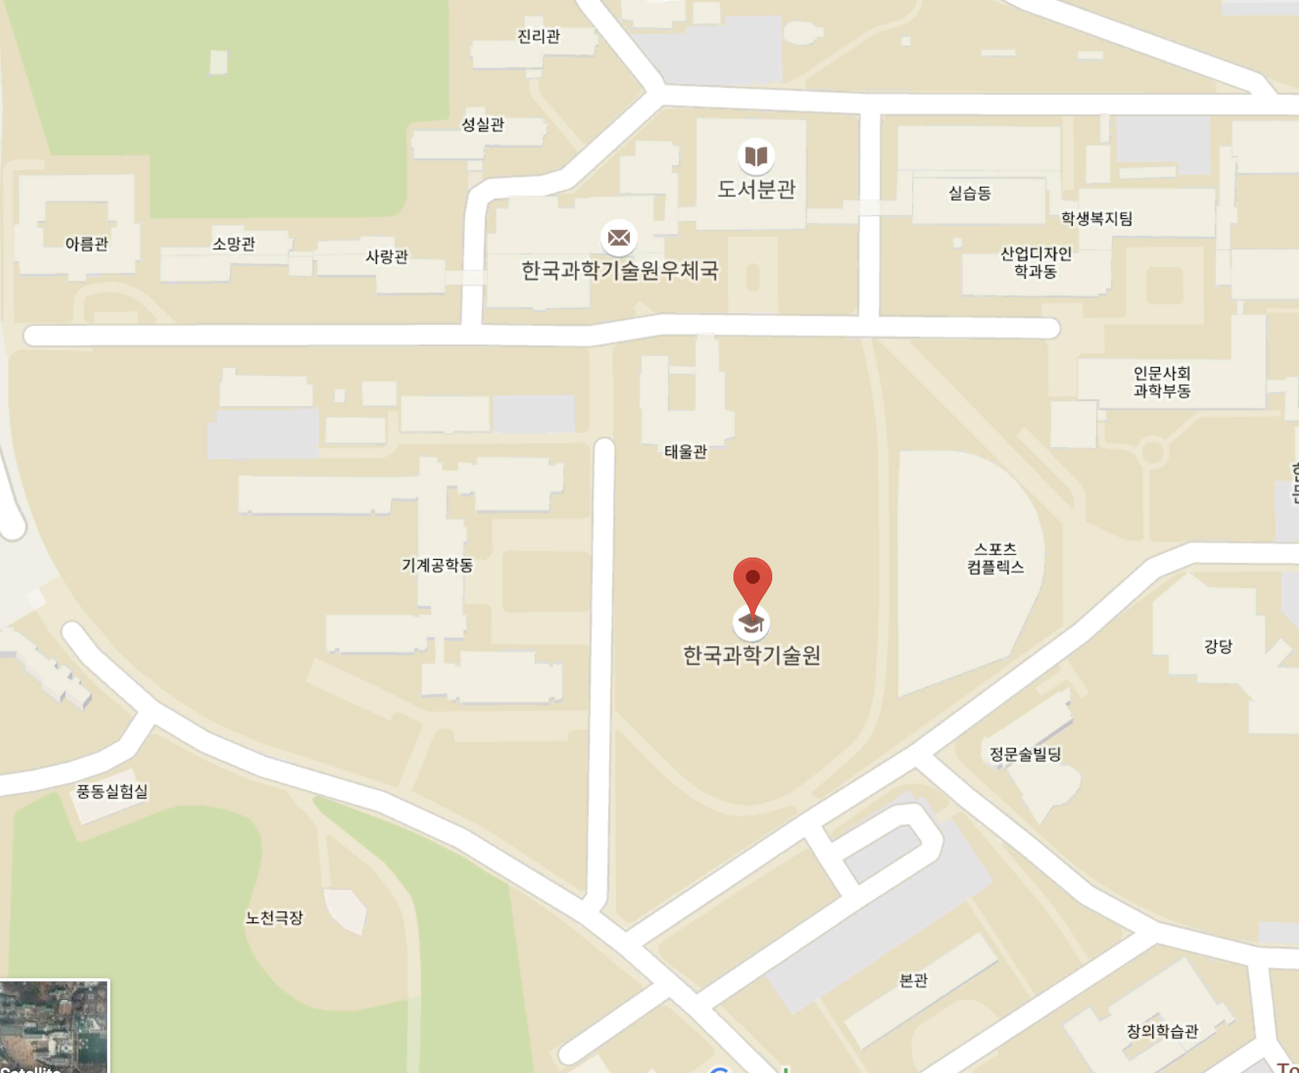



We can
detect
biking in the wrong lane
}
Notes:
For checking whether users were on the correct lane...

Slide 19
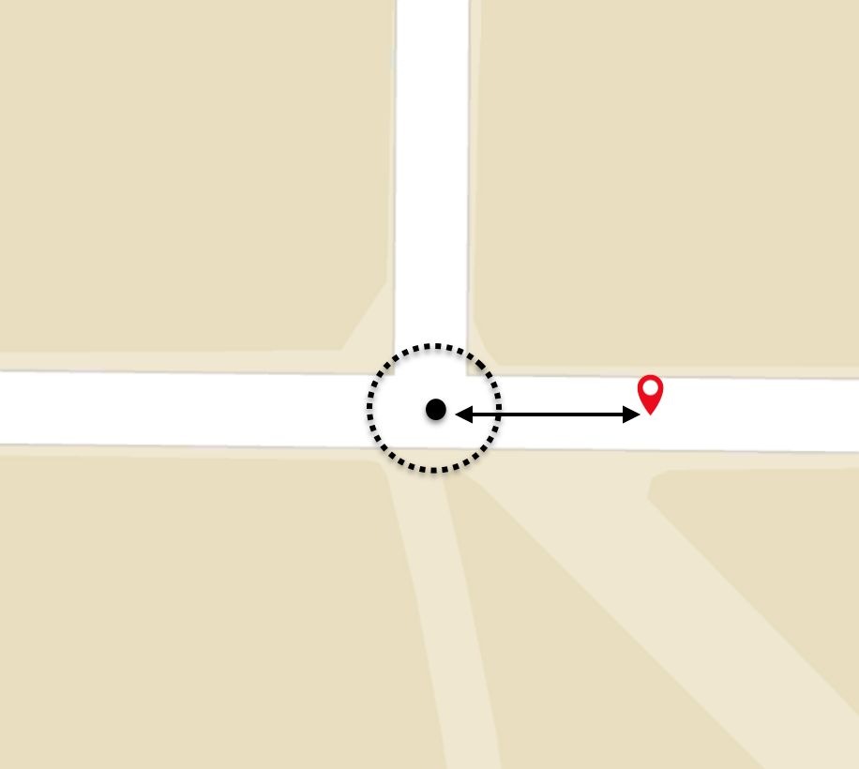
We can detect speeding near intersections
Notes:
For..

Slide 20
Part 2: Social Gamification
Detection
Social Gamification

Slide 21
?
Detection and Feedback
Interviews with 6 Bikers
Long-term
Behavior
Change
Notes:
If we can find when unsafe biking and provide feedback, how do we make this into long term change? Conducted interviews to understand bikers better, why they bike unsafely, what could get them to change, why they would use an app like ours

Slide 22
Know they’re unsafe and know what is unsafe, but not willing to change, because it’s convenient
Incentives > Convenience
“Because it's convenient to do all these dangerous things”
Notes:
Our main finding from these interviews was that the bikers know that they’re unsafe and know it is unsafe but are not willing to change
Because It’s convenient adn don’t think its dangerous

Slide 23

Gamification
the process of adding games or game-like elements to something (such as a task) so as to encourage participation

Slide 24

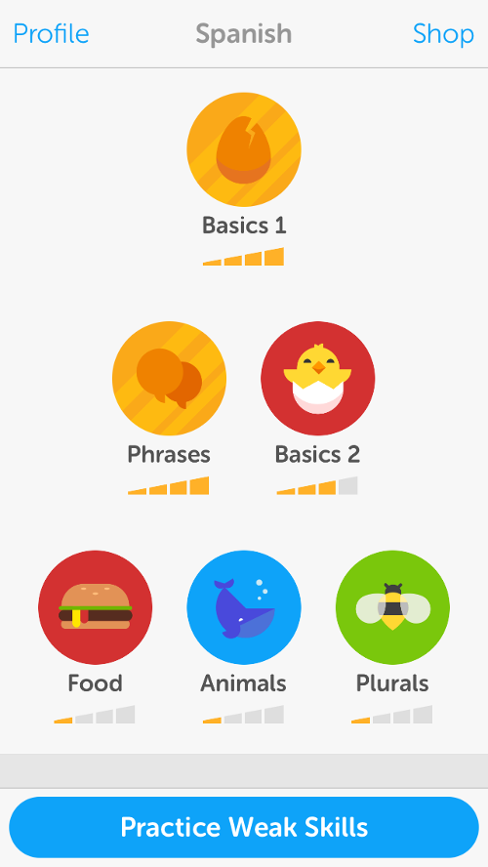
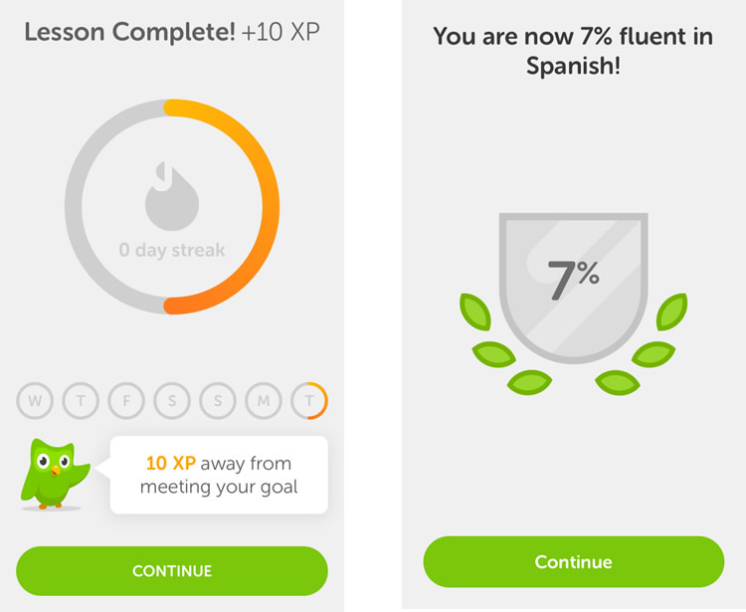

Gamification is key to their success
“We needed to try to encourage people to form a daily learning habit. We found that the most effective techniques for this come from the gaming world.”

Slide 25
Gamification
Detection and Feedback
Long-term
Behavior
Change
Notes:
If we can find when unsafe biking and provide feedback, how do we make this into long term change? Conducted interviews to understand bikers better, why they bike unsafely, what could get them to change, why they would use an app like ours

Slide 26







Notes:
Games have different features, cannot do all Our approach to narrow down to what could be the most effective was to find what KAIST students appreciate in games in general, what makes them game, what makes them to keep coming Conducted survey to find what are the main

Slide 27
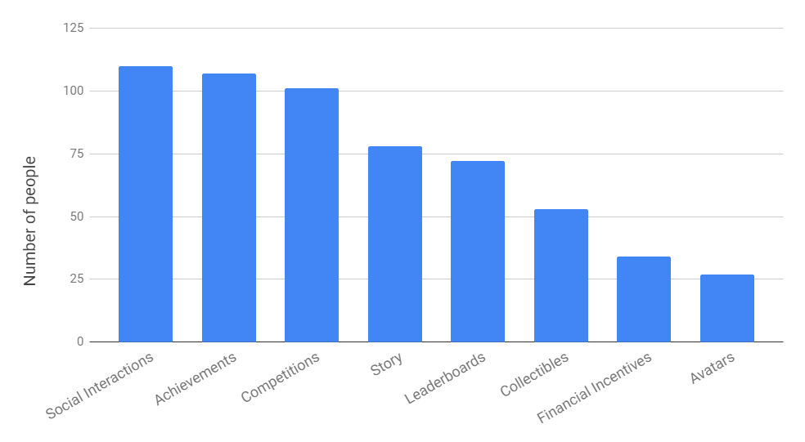
Top 3 Reasons that Motivate KAIST Students to Play
(1) Social Interactions
(2) Achievements
(3) Competitions
Notes:
So from our survey, these 3 were relatively the most chosen ones
We could use these ideas and incoorporate versions of them to our application

Slide 28

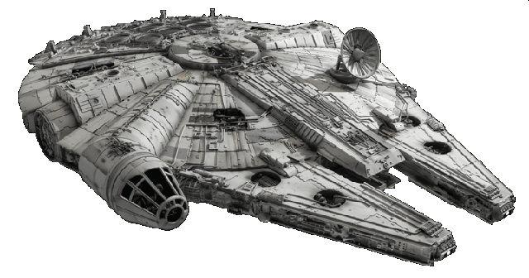

Space Battles
Raising a Nupjooki 넙죽이 키우기
NOT FINAL!

Slide 29





Space Battles
FIRE
Notes:
Make teams within application, you all board a spaceship
Every few days get matched against an opponent team
Each time members of your team bike safely, it grants laser beam ammo to your spaceship
Users can then use these to shoot at the other spaceship
Whichever team damages other spaceship most wins and grants points in leaderboard

Slide 30

Space Battles
VICTORY!
Notes:
Make teams within application, you all board a spaceship
Every few days get matched against an opponent team
Each time members of your team bike safely, it grants laser beam ammo to your spaceship
Users can then use these to shoot at the other spaceship
Whichever team damages other spaceship most wins and grants points in leaderboard

Slide 31





Raising a Nupjooki
Achievement
Taesoo’s Nupjook
10 KM in 1 Day
Notes:
Make teams within application, you all board a spaceship
Every few days get matched against an opponent team
Each time members of your team bike safely, it grants laser beam ammo to your spaceship
Users can then use these to shoot at the other spaceship
Whichever team damages other spaceship most wins and grants points in leaderboard

Slide 32






Raising a Nupjooki Nupjooki Fashion Contest
Sejoon’s
Chanju’s
Taesoo’s

Slide 33
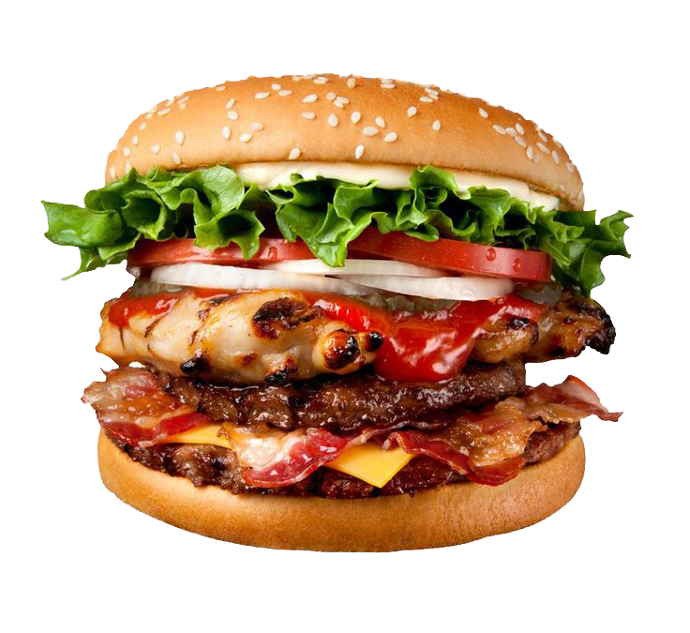
Goal: Our App = Delicious Burger
Detection
Gamification
Special Sauce
Leveraging social dynamics
Designed for KAIST students and campus
Notes:
So if we consider ou app to be a burger, detection will be the bun. It holds everything together, its the reason that burger is a burger and not a hamburger steak
The gamification is the meat. It’s the core of the burger and it’s what you order the burger for and what one enjoys the most
And then there’s our special sauce, what differentiates our burgers from all others:
These are the fact that we are going to leverage social dynamics to increase interest in our app
And the fact that this app is specifically designed with KAIST students and the KAIST campus in mind, which can allow us to more easily detect several unsafe biking behaviors (like we can manually find all the dangerous intersection points in campus)
Previous works:
KAIST efforts: pamphlets, fines
BikeSafe/BikeMate: only monitor, no feedback
Biketastic: only detect bad roads, not bad biking behavior
All not long term or motivating oriented, simply detection + no/bad feedback.

Slide 34
Thank You!
Notes:
So if we consider ou app to be a burger, detection will be the bun. It holds everything together, its the reason that burger is a burger and not a hamburger steak
The gamification is the meat. It’s the core of the burger and it’s what you order the burger for and what one enjoys the most
And then there’s our special sauce, what differentiates our burgers from all others:
These are the fact that we are going to leverage social dynamics to increase interest in our app
And the fact that this app is specifically designed with KAIST students and the KAIST campus in mind, which can allow us to more easily detect several unsafe biking behaviors (like we can manually find all the dangerous intersection points in campus)
Previous works:
KAIST efforts: pamphlets, fines
BikeSafe/BikeMate: only monitor, no feedback
Biketastic: only detect bad roads, not bad biking behavior
All not long term or motivating oriented, simply detection + no/bad feedback.

Slide 35
Bring in bikers
Show them paper prototypes for different gamification ideas
Let them interact with them while prompting them with questions
Make them choose their favorite
Gamification
Tentative Testing
Methods
Finish application early for long-term testing
Conduct a pre-survey
Test application for 2 weeks
Compile data from application & conduct post-survey
Long-term Behavior Change
Notes:
Paper protoypes- don’t need to be bad bikers.

